Slide 1
Configuration and Customization for the Non-Developer
Mitch Milam

Slide 2
Email
mitch@xrmcoaches.com
Twitter
@mitchmilam
Blogs
blogs.infinite-x.net ( developer )
rockmycrm.com ( user )
Tools
crmaccelerators.net

Slide 3
Agenda
Configuration
Customization
Automation

Slide 4
Part 1: Configuration

Slide 5
Business Units
Definition
When to use
When to not use
Notes:
----- Meeting Notes (11/8/11 08:50) -----

Slide 6
Exercise: Create a Business Unit
Name:
Headquarters
Parent Business
AdventureWorksCycles
(or)
Contoso

Slide 7
Proper Utilization of Security Roles
Security roles defined
How are security roles applied
Privileges
User
Business Unit
Parent: Child Business Units
Organization

Slide 8
Demonstration
Salesperson role

Slide 9
Security Role Tips
ALWAYS copy an existing role.
DO NOT create a new role from scratch
ONLY add privileges that are required by the role

Slide 10
Security Privilege Tips
Double-clicking the column or row header will cycle the column or row

Slide 11
Exercise: Create a new security role
Select the Salesperson role
Select More Actions, Copy Role
New Name:
Sales Supervisor
Clear all privileges
Save the role

Slide 12
Using Templates
Template types
Articles
Emails
Contracts
Mail Merge

Slide 13
Exercise: Create an Email Template
Template Type:
Contact
Title:
Happy holidays
Subject
Happy holidays
Description:
Dear [Firstname],
Have a happy holiday
[enter signature block]
Save and Close

Slide 14
Exercise: Create an Email Template, Part 2
Open Contacts
Select several contacts
Click the Add tab
Select Quick Campaign
For Selected Records
Enter a quick campaign name
Select email
Select your template
Click Next, then Create
Go to Activities and review pending emails

Slide 15
Using Queues
Creating a queue
Email enabled, or not
Practical usage

Slide 16
Exercise: Create a Queue
Select Settings, Business Management
Click Queues
Click the New button
Add Queue properties
Name
Email address ( optional )
Incoming email setting
Email Configuration settings

Slide 17
Part 2: Customization

Slide 18
Customization Basics
What to customize
When to customize
Repurpose vs. create new

Slide 19
Customization Basics
Changing the customization prefix for the default publisher

Slide 20
Exercise: Change the Customization Prefix
Select Settings, Customizations
Select Publishers
Open the Default Publisher
Change the prefix to match your organization’s initials
Click Save and Close

Slide 21
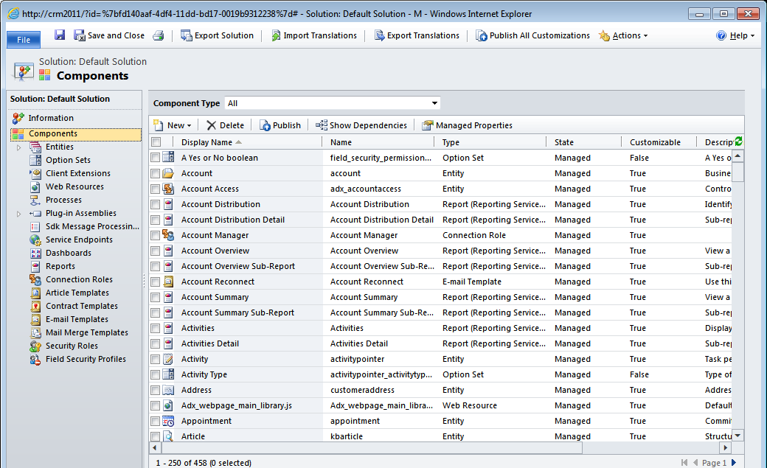
Default Solution Tour

Slide 22
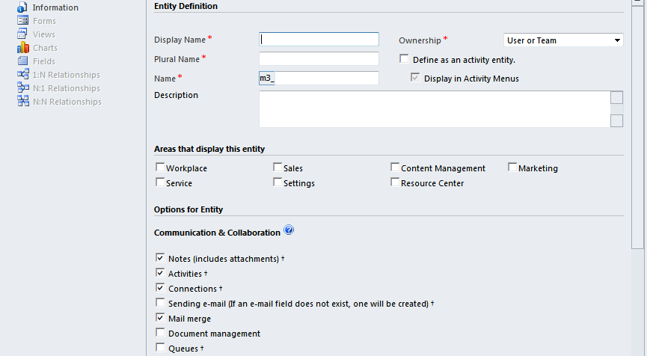
Adding New Entities

Slide 23
Exercise: Create Entity

Slide 24
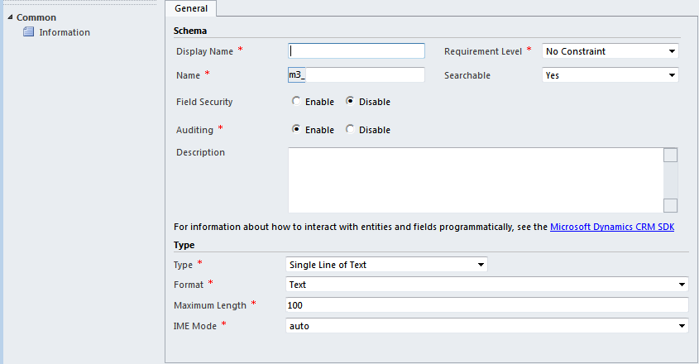
Adding New Fields

Slide 25
Exercise: Add New Fields

Slide 26
Customizing Forms

Slide 27
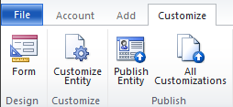
Cool Customization Feature
Customize a form, from the form

Slide 28
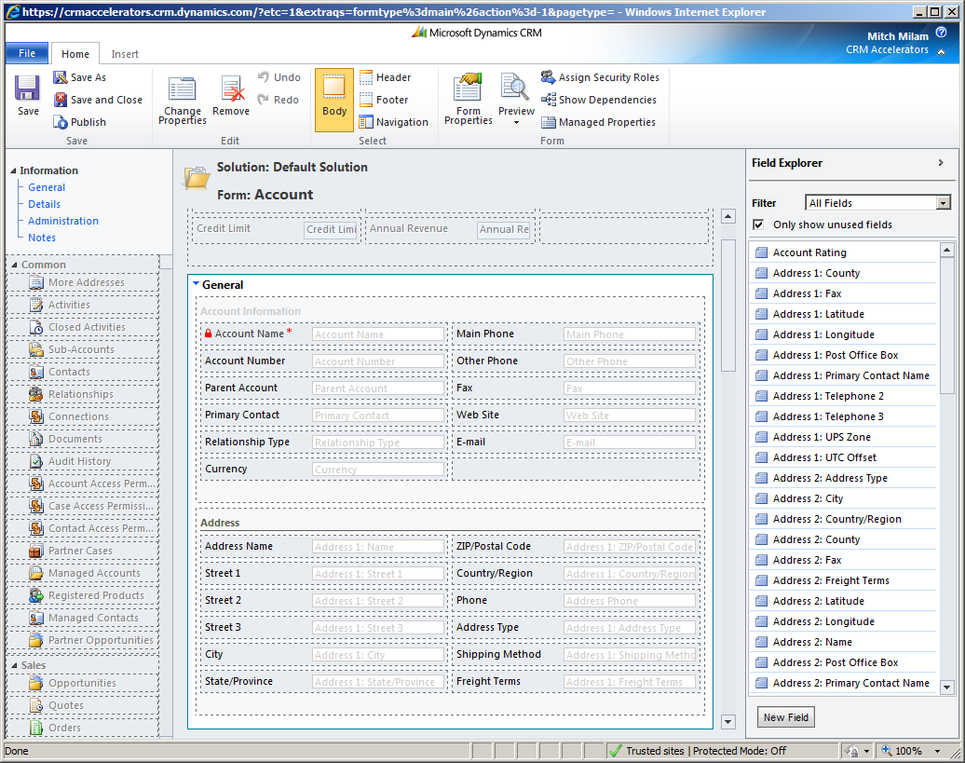
CRM 2011 Form Designer

Slide 29
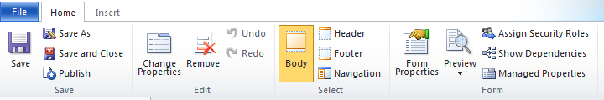
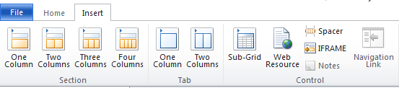
Form Designer-Ribbon
Main Ribbon
Insert Ribbon

Slide 30
Form Designer-Additions
Drag and drop interface
10 levels of Undo/Redo
Explorer window is context sensitive
Create items directly from the form editor

Slide 31
Form Designer-Tabs and Sections
Tabs can have columns
Column width can be adjusted
Tabs can be visible by default
Section layout can be changed
Any time after creation
Sections can be visible by default

Slide 32
Form Designer-Fields
Field label alignment
Left, right, or center
Field label position
Side, top
Fields can be visible by default

Slide 33
Tip: Field Label Placement
Do not start moving field labels anywhere unless you wish to do so everywhere
Inconsistency annoys users
Annoyed users make phone calls

Slide 34
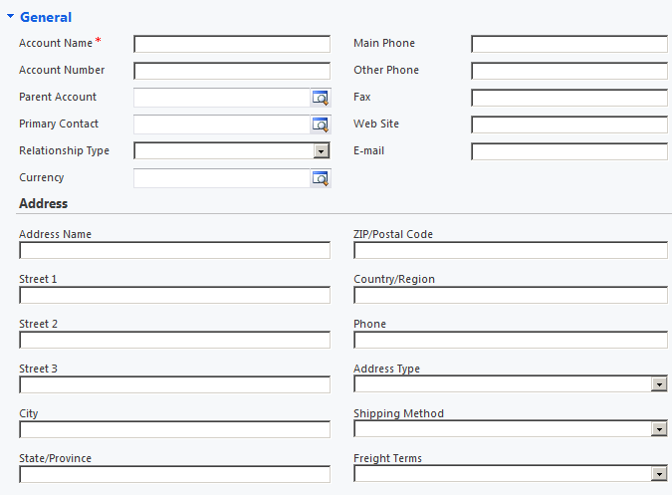
Example: Field Label Placement

Slide 35
Tip: Keyboard Shortcuts
Arrow Keys
Move the selected item
Delete key
Deletes an item
Enter Key
Displays the property dialog
Ctrl+Z, Ctrl+Y, Ctrl+S
Undo, Redo, Save

Slide 36
Working with Views
Available views
Defining a new view
Adding columns
Adding sort criteria
Adding filter criteria ( if applicable )

Slide 37
Exercise: Add a New View

Slide 38
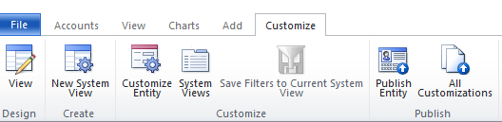
Customizing Views
Customize a view, from the view

Slide 39
Field-Level Security
You may only secure custom fields
Security profiles are user/team-based

Slide 40
Exercise: Add Field-Level Security
Select a custom field
Enable Security
Publish customizations
Create a Field Security Profile
Test the security

Slide 41
Auditing
Must be turned on in the following order:
Organization, Entity, Field
Don’t go Crazy
Auditing data cannot be reported on
Auditing data cannot be exported through the CRM 2011 user interface
You can programmatically access auditing data

Slide 42
Exercise: Enable and Test Auditing
Enable auditing in the organziation
Verify auditing is enabled for Contact
Verify auditing is enabled for Fields:
City
State
Zipcode
Change a record’s values
Review the audit log

Slide 43
Visualizations
Creating a basic chart
Select a view
Select a legend series
Select an operator
Select a horizontal category

Slide 44
Exercise: Creating a Chart
Open the Entity Contact
Select Charts
Click the New button

Slide 45
Exercise: Creating a Chart. Part 2
Select the Active Contacts View
Enter a Name
Legend Series (Series)
Address 1: State/Province
Count: Non-Emptys
Horizontal (Category)
Address 1: State/Province
Publish All customizations
Review your work

Slide 46
Implementing Dashboards
Charts
Lists
iFrames

Slide 47
Exercise: Create a Dashboard
From the Default Solution:
Open Dashboards
Click the New button
Select a dashboard type
Click Create
Populate your dashboard with components

Slide 48
Part 3: Automation

Slide 49
Workflows
Automation overview
What COULD you automate?
What SHOULD you automate

Slide 50
Automation Activities
Check for something
Wait for something
Do something

Slide 51
Running Workflows
Automatically
On-Demand

Slide 52
Automatic Process Options
Limit the scope
Start when
Record is created
Record status changes
Record is assigned
Record fields change
Record is deleted

Slide 53
Exercises: Creating Workflows

Slide 54
Managing Workflows
Navigating the System Jobs view
Creating a custom view to find halted workflows
Monitor and clean up completed workflows
System settings vs. bulk delete jobs

Slide 55
Q & A

